Slide 1

Software Design Flow

Slide 2
Sapphire SoC IDE Backward Compatibility
The Efinity software v2023.2 includes the Efinity RISC-V Embedded software IDE for developing RISC-V software applications. The IDE provides an enhanced environment for developing embedded applications, and Efinix recommends that all users switch to it. The IDE has these features and advantages:
Optimized process for importing projects
Eliminates redundant steps to import C/C++ Project Settings
Simplifies the sample projects import process with tick boxes
Automatically loads the correct C/C++ project settings for both standalone and FreeRTOS sample programs

Slide 3
Ability to automate makefile generation for new project creation
Integrated QEMU emulator for 32-bit RISC-V Core
Bundled with project examples
Allows you to debug without hardware

Slide 4
Flexible workspace directory
RISC-V IDE allows you to point to your project’s BSP and FreeRTOS Kernel
Eliminates the need to copy the FreeRTOS Kernel folder to each project's directory, embedded_sw/<SoC module>/software
Easier debug experience
CSR Register View
Peripheral Register View
FreeRTOS Queue and Task List View

Slide 5
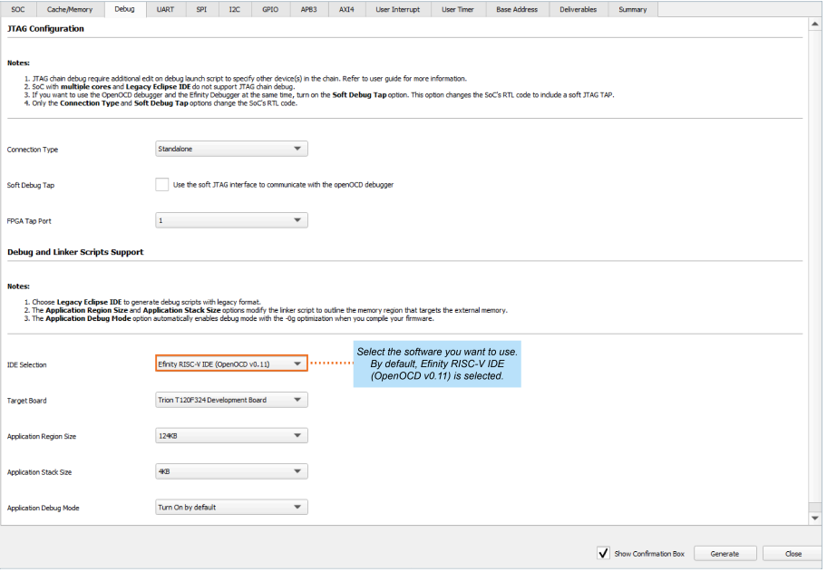
When you configure your SoC in the Efinity IP Manager, the IDE Selection parameter is provided in the Debug tab. If you intend to use the open-source Eclipse software in the RISC-V SDK, select the Legacy Eclipse IDE (OpenOCD v0.10) option. By default, Efinity RISC-V IDE (OpenOCD v0.11) is selected.

Slide 6
Launching the Efinity RISC-V Embedded Software IDE
Launch the Efinity RISC-V Embedded Software IDE by double-clicking on the Efinity RISC-V IDE shortcut available in the efinity-riscv-ide- folder (example: efinityriscv-ide-2022.2.3).
For easy access, you may transfer the shortcut to the desktop. A new IDE window opens once the IDE is successfully invoked.

Slide 7
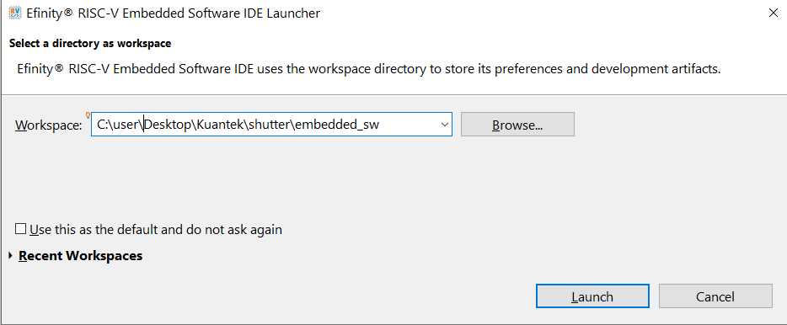
You need to select a workspace directory to store the IDE's preferences, configurations and temporary information. Follow these steps:
Click Browse and select your preffered location.
You may click the Recent Workspaces to select a previous workspace.
Click Launch.

Slide 8
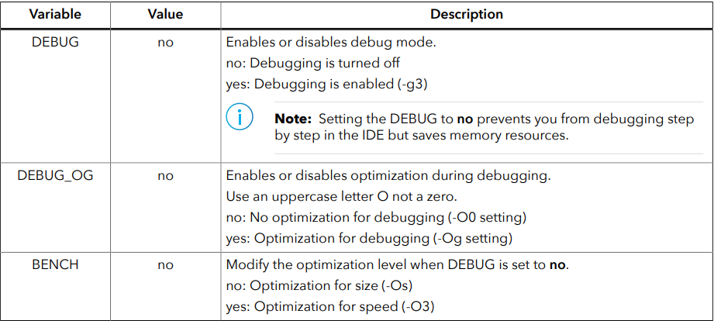
Optimization Settings
OpenOCD uses three environment variables, DEBUG, BENCH, and DEBUG_OG.
It is simplest to set them variables as global environment variables for all projects in your workspace. Then, you can adjust them as needed for individual projects.

Slide 9
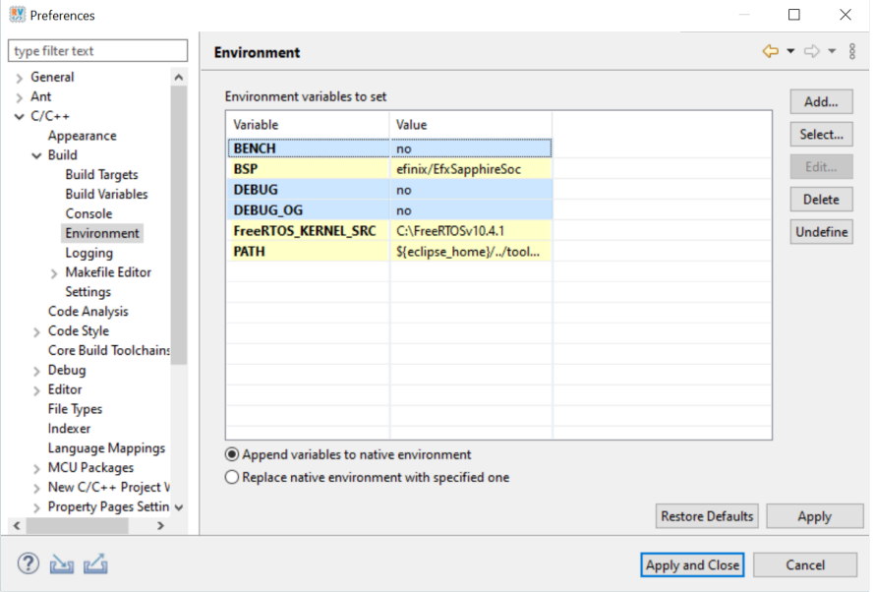
Choose Window > Preferences to open the Preferences window and perform the following steps.
In the left navigation menu, expand C/C++ > Build.
Click C/C++ > Build > Environment.
Click Add to add the following environment variables.
Click Apply and Close.

Slide 10
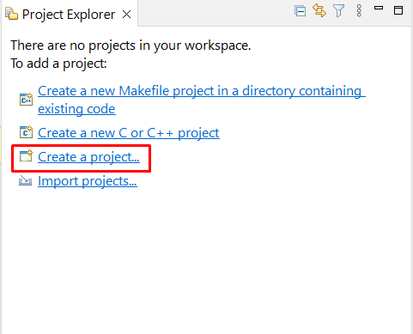
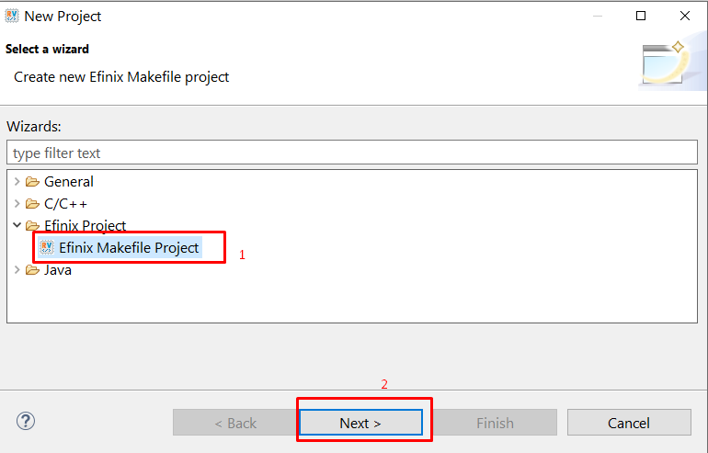
Create a New Project
In the Project Explorer:
Click Create a Project to open the new project wizard.
Select the Efinix Project > Efinix Makefile Project > Next . In the New Efinix Makefile Project Wizard window:

Slide 11
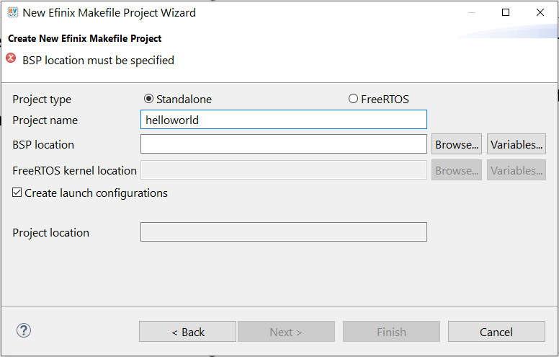
Select either Standalone or FreeRTOS project type. With this selection, the IDE imports the required header files.
Enter your project name. Whitespaces cause error and prevent you to complete the new project creation.

Slide 12
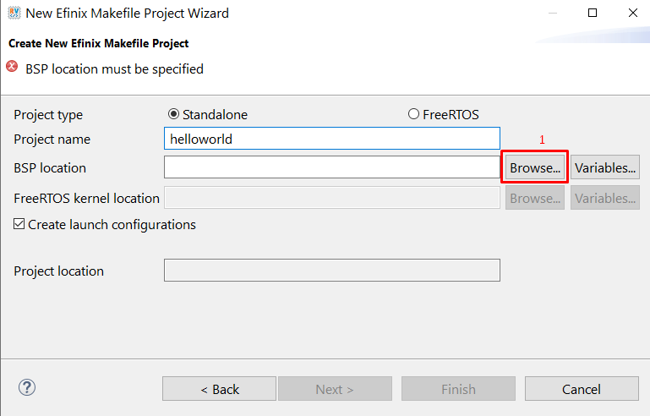
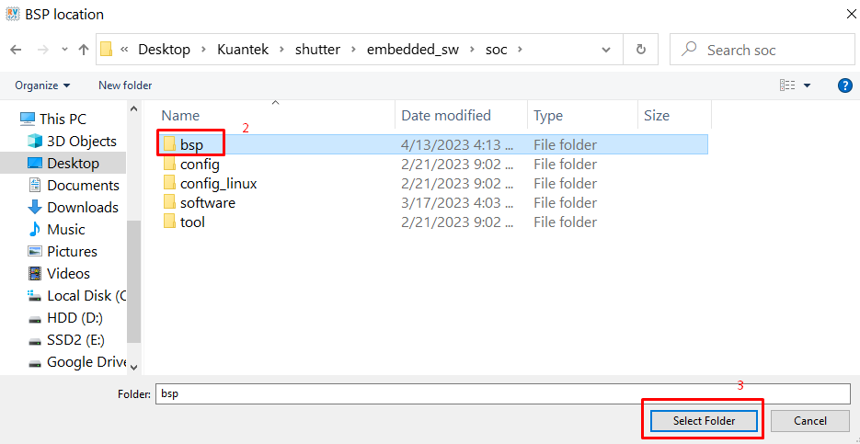
Click on Browse > Board Support Package (BSP). BSP location is generated by Efinity when you generate the Sapphire SoC with the IP Manager. Example BSP location: C:/<Project name>/embedded_sw/<ip name>/bsp/.

Slide 13
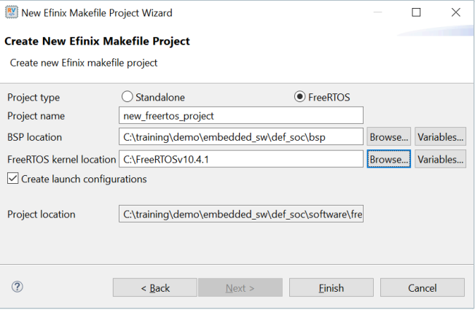
Select FreeRTOS, browse to the FreeRTOS kernel location. Example FreeRTOS kernel location: C:\FreeRTOSv10.4.1. The location should point to the folder containing the FreeRTOS, FreeRTOS-Plus, and tool folders.
The new project location shows up.
Click Finish.
Note: Efinix recommends you use FreeRTOSv10.4.1 for development and verification purpose. You may download the FreeRTOS here.

Slide 14
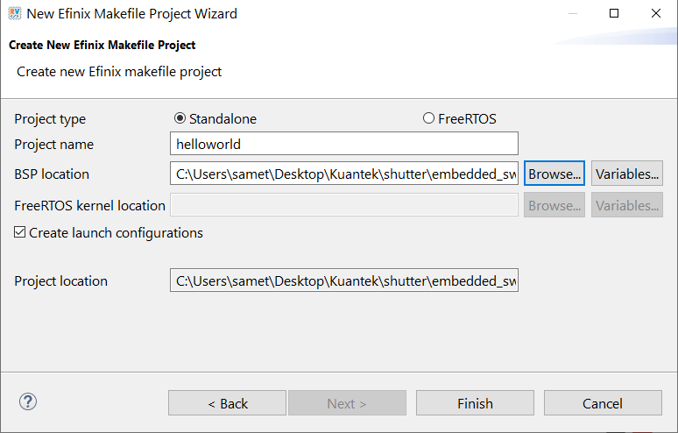

Slide 15
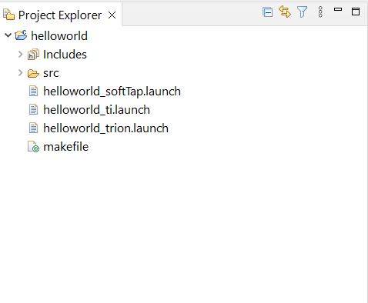
The new projects are updated in the Project Explorer pane. All required files are imported automatically. Launch scripts for softTap, ti, and trion configurations are generated automatically.

Slide 16
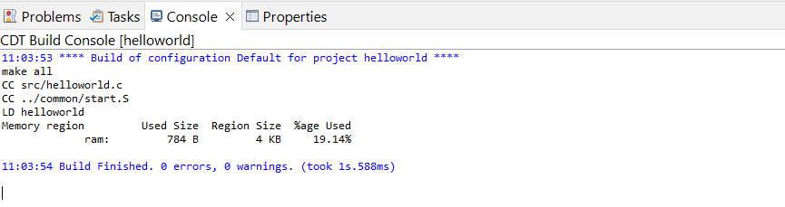
You can now browse the source files. To build the project, right-click on the project and select Clean Project > Build Project. The compilation output shows in the Console window.

Slide 17
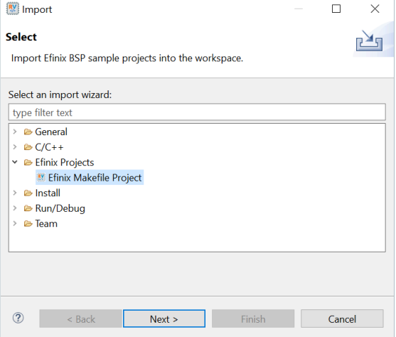
Import Sample Project
Efinix provides sample projects to help you get started with Sapphire SoC. The sample projects are generated with the Efinity software. The followings steps explain how to import existing projects into the IDE:
In the Project Explorer, click on Import Projects... to open the Import wizard.
2. In the Import wizard, select Efinix Makefile Project in Efinix Projects and click Next.

Slide 18
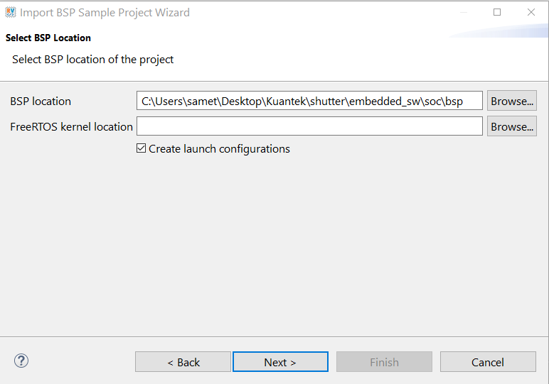
In the Import BSP Sample Project Wizard, click Next to browse to the next BSP location box.
If you would like to import the FreeRTOS sample projects, browse to the FreeRTOS kernel location. Turn on Create launch configurations and click Next.

Slide 19
The next wizard page shows the Import BSP Sample Project Wizard, all sample projects are located in the embedded_sw/<soc name>/software are shown. Follow these steps:
Turn on the specific project to import that project.
You may turn on the sub-category, for example: Free RTOS, to import all the projects belonging to that particular sub-category.
Alternatively, you may click Select all / Deselect all to select or deselect all the projects available.
Click Next.

Slide 20
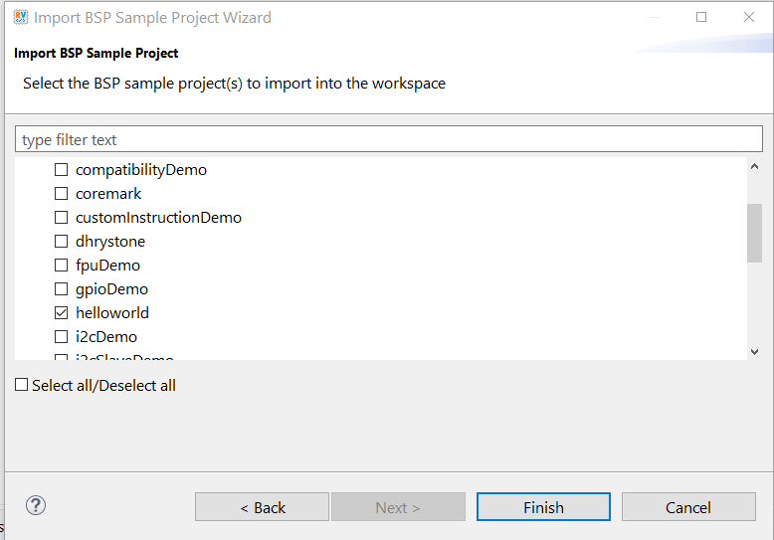

Slide 21
The selected sample projects are imported into the listed workspace in the Project Explorer pane.

Slide 22
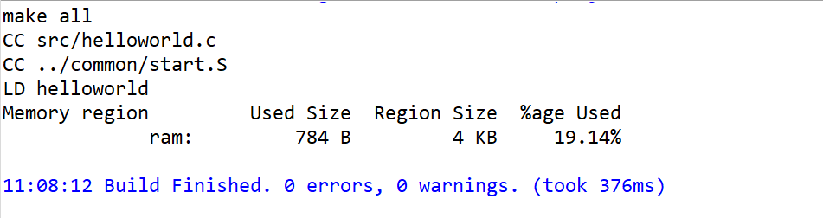
You can now browse the source files. To build the project, right-click the project name and select Clean Project > Build Project. The compilation output shows up in the Console window.

Slide 23
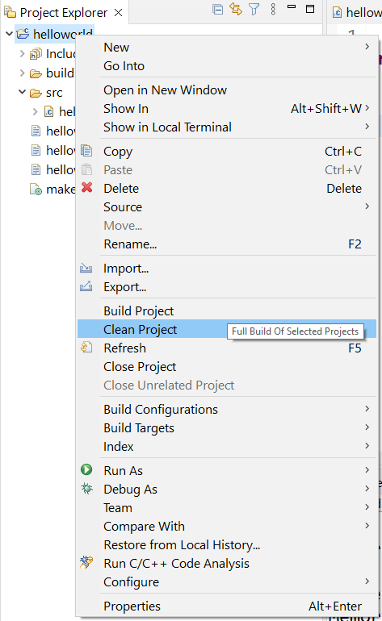
Build
Choose Project > Build Project or click the Build Project toolbar button. Alternatively, right-click the project name in Project Explorer > Build Project.
Efinix recommends cleaning your project before building to ensure all files are compiled. To clean project, right-click on the project in Project Explorer > Clean Project.

Slide 24
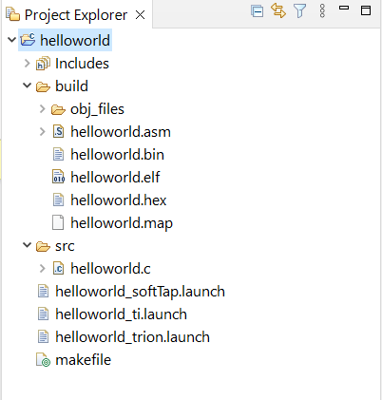
The makefile builds the project and generates these files in the build directory:
<project name>.asm—Assembly language file for the firmware.
<project name>. bin—Firmware binary file. Download this file to the flash device on your board using OpenOCD. When you turn the board on, the SoC loads the application into the RISC-V processor and executes it.

Slide 25
<project name>. elf—Executable and linkable format. Use this file when debugging with the OpenOCD debugger.
<project name>. hex—Hex file for the firmware. (Do not use it to program the FPGA.)
<project name>. map—Contains the SoC address map.

